Slide 1
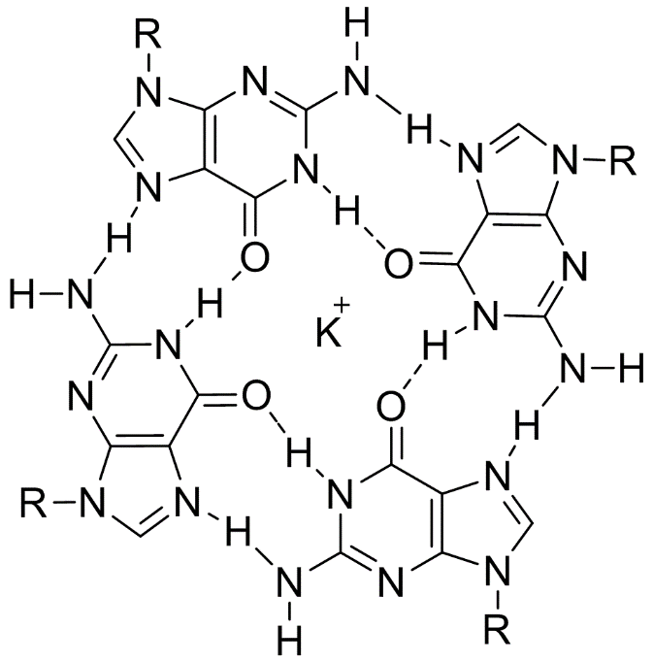
UMUC G-Quadruplex Identification Working Group
Final Presentation

Slide 2
GFinder and Halobacterium salinarum
Defining feature of Halobacterium salinarum is ability to resist radiation with continued growth
supports a model of robust DNA repair being possible
H. salinarum have high G-C content in their genome creating favorable conditions for presence of G-quadruplex-forming sequences
GOAL - Create GFinder tool to:
search Halobacterium sp. NRC-1 for candidate G-quadruplex sequences
use candidate sequences in BLAST search to look for placement in currently identified genes
produce searchable, sortable output of results

Slide 3
GFinder and Halobacterium salinarum (cont.)
G-quadruplexes form in areas where bases associate via Hoogsteen hydrogen bonding -> form planes that stack
Prioritize search parameters and flexibility in GFinder to extend capabilities
G-quadruplex loop lengths have been found to be as short as 5, as long as 30
Initial project task is for NRC-1, but other genomes are of interest
Initial task is to BLAST against same genome, but might want another
GFinder tool accepts user inputs to determine genome in which to identify candidates, length of loop, genome to be BLAST searched
Final output contains information on candidate G-quadruplex sequences as well as information on putative hits

Slide 4
NCBIFetch and Final Configurations

Slide 5
NCBI Fetch
What is NCBIFetch?
BioJava = external source
How does it work ?
Wrapper objects and methods from BioJava package
Why was NCBIFetch used?
Best approach to retrieve sequences from NCBI and to write them in a readable file to our program.
BioJava methods are specific to bioinformatics processes.

Slide 6
Accession numbers for user input
Accession numbers used in testing and deployment of GFinder:
AE004437 - Halobacterium sp. NRC-1, complete genome
AE004438 - Halobacterium sp. NRC-1 plasmid pNRC200
AF016485 - Halobacterium sp. NRC-1 plasmid pNRC100

Slide 7
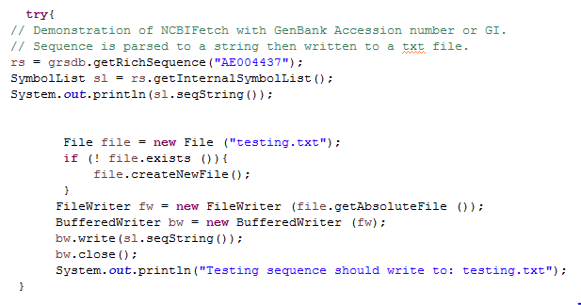
NCBIFetch Syntax for GFinder

Slide 8
Evolution of RegEx for GFinder

Slide 9
Initial RegEx pattern for GFinder
Default G-quadruples algorithm:
G>/=3Nx G>/=3Nx G>/=3Nx G>/=3Nx
Initial GFinder regex pattern:
([gG]{3,}\\w{1,7}){3,}[gG]{3,}
Identified 3 candidate sequences within the pNRC100Plasmid of NRC-1

Slide 10
Methods to enhance GFinder regex pattern to identify all relevant candidate G-quadruplex sequences
Expansion of limit of found nucleotides between guanines (loop for G-quadruplex motif)
([gG]{3,}\\w{1,30}){3,}[gG]{3,}
Identified 55 candidate sequences within the pNRC100Plasmid of NRC-1
Further fine tuning of pattern looping
([gG]{3,}\\w{1,30}){2,}[gG]{3,}
Identified 138 candidate sequences within the pNRC100Plasmid of NRC-1

Slide 11
Review of Code for GFinder

Slide 12
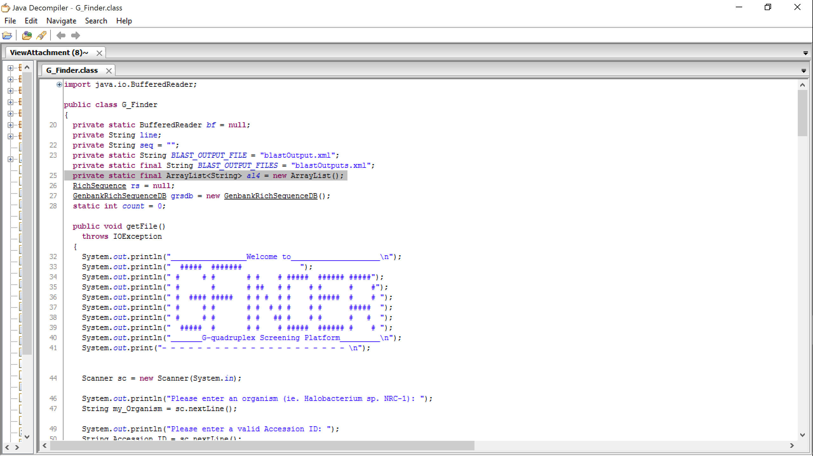
The GFINDER Code

Slide 13
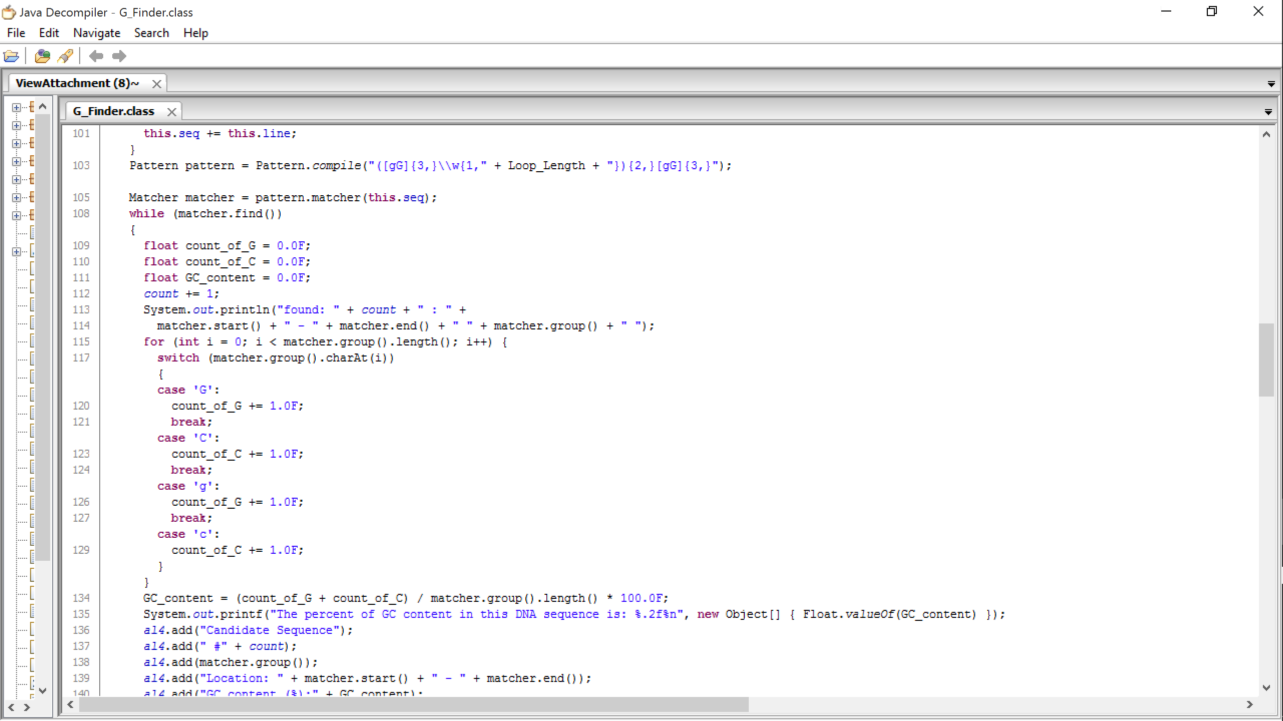
GFinder Code- regular expression component

Slide 14
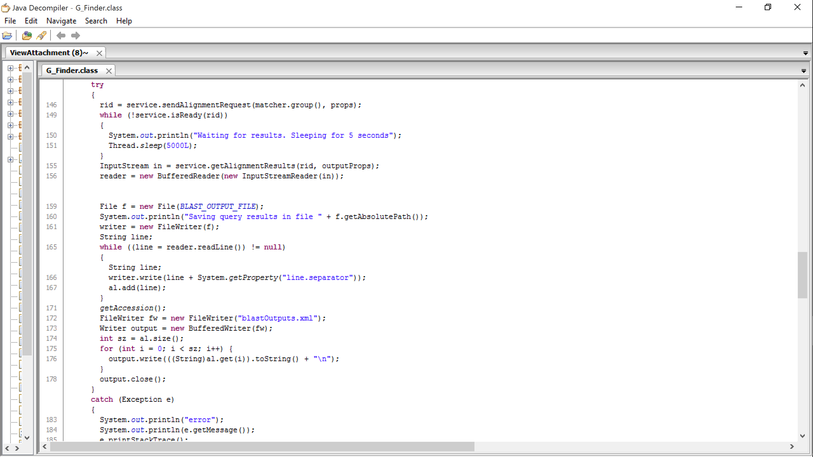
GFinder Code- BLAST search component

Slide 15
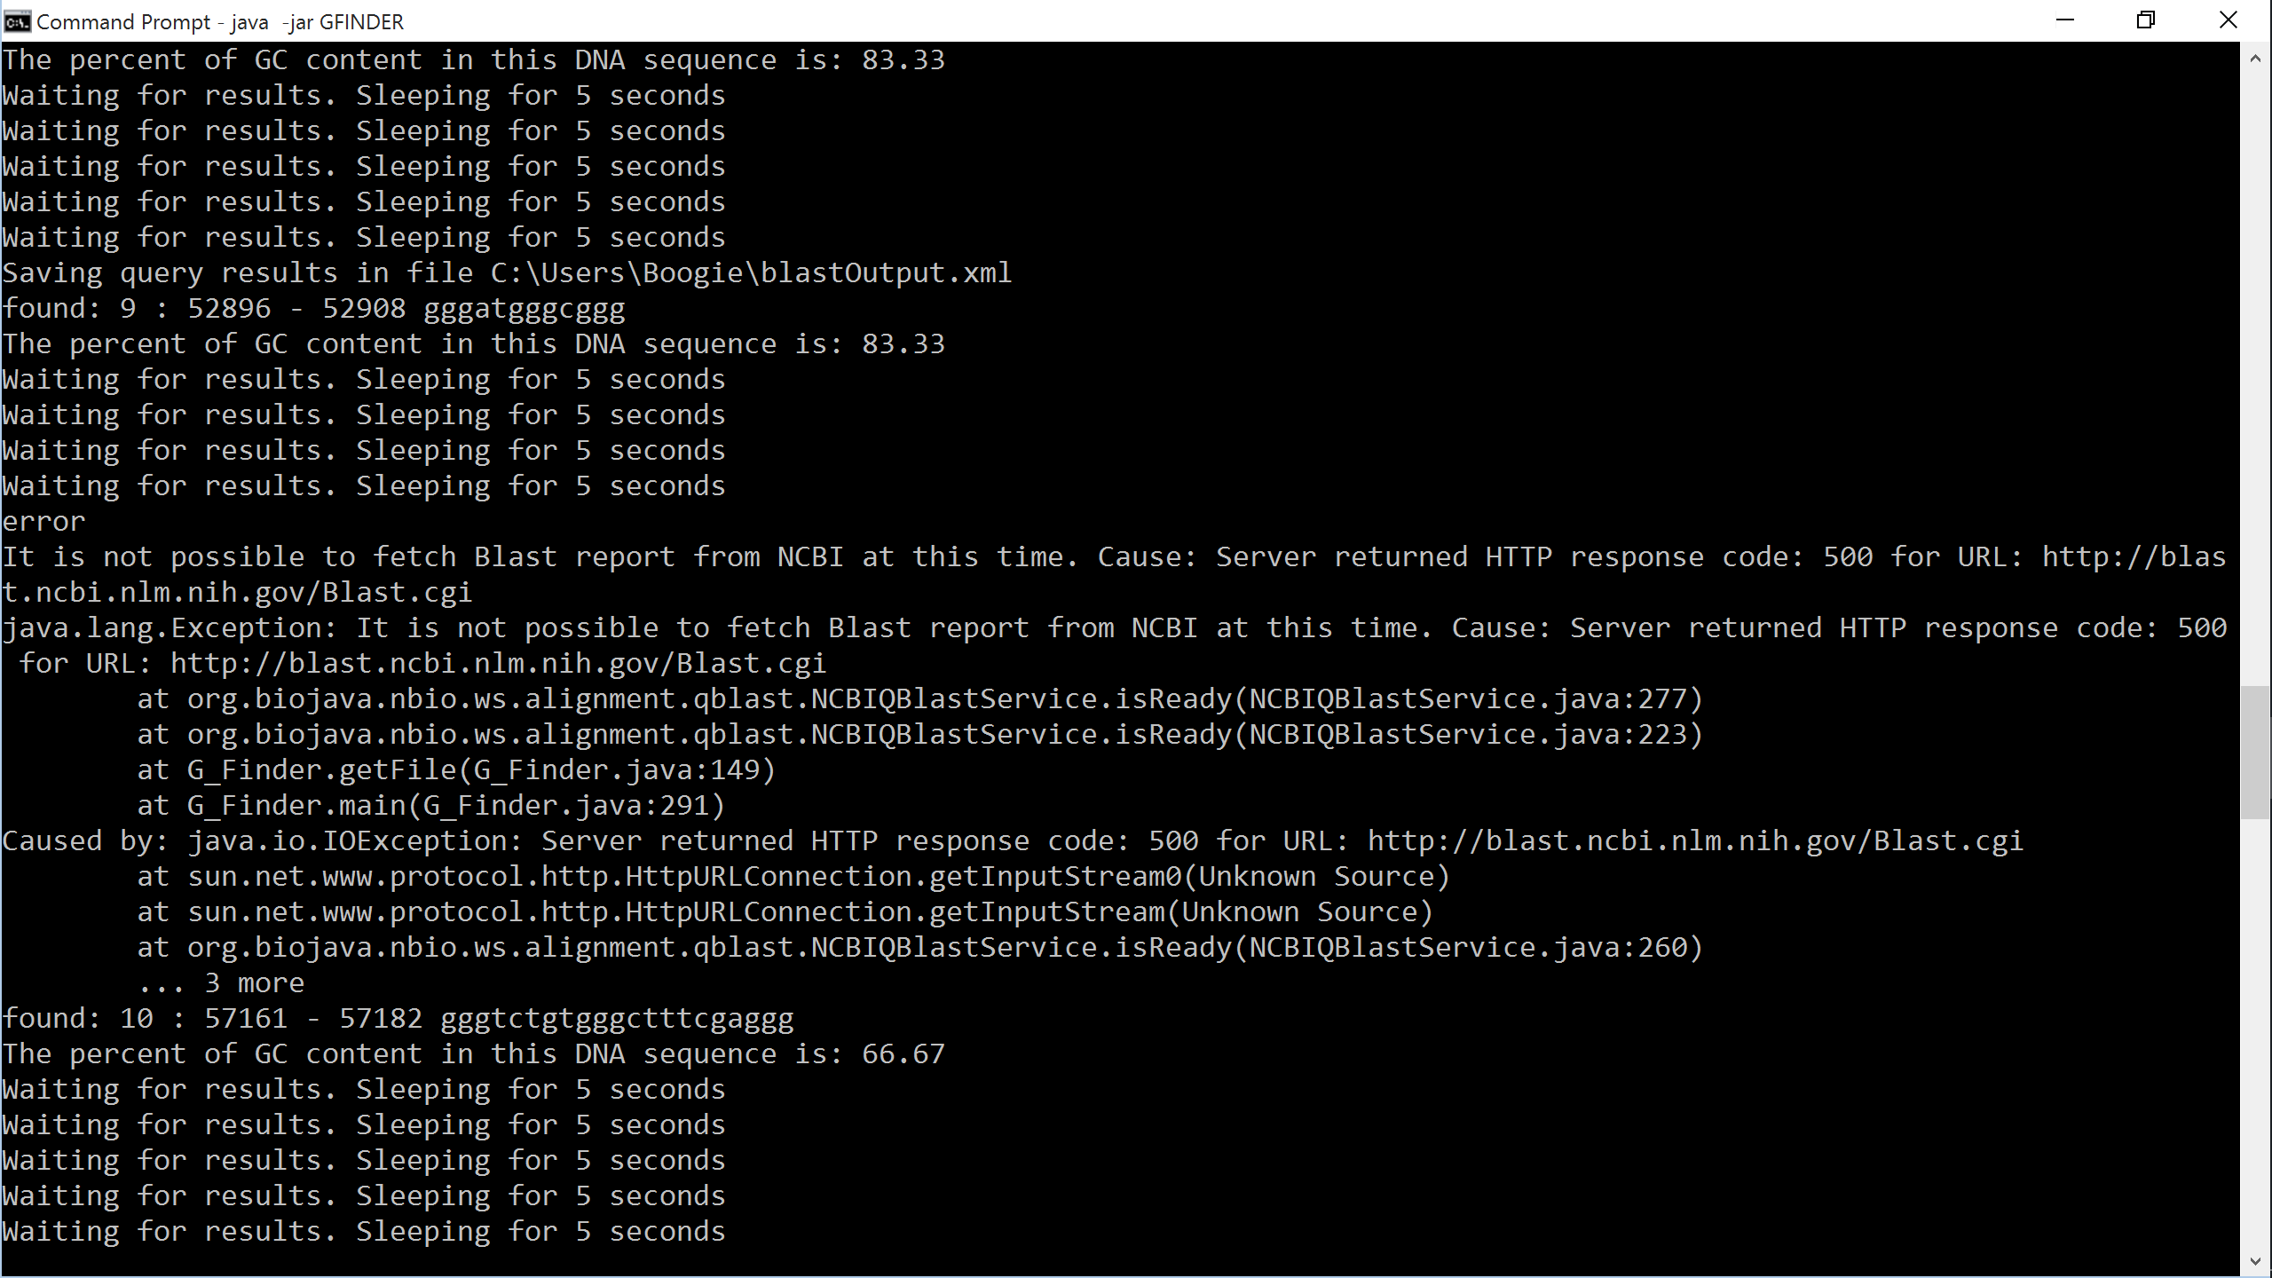
GFinder Code- BLAST search errors/Issues with search

Slide 16
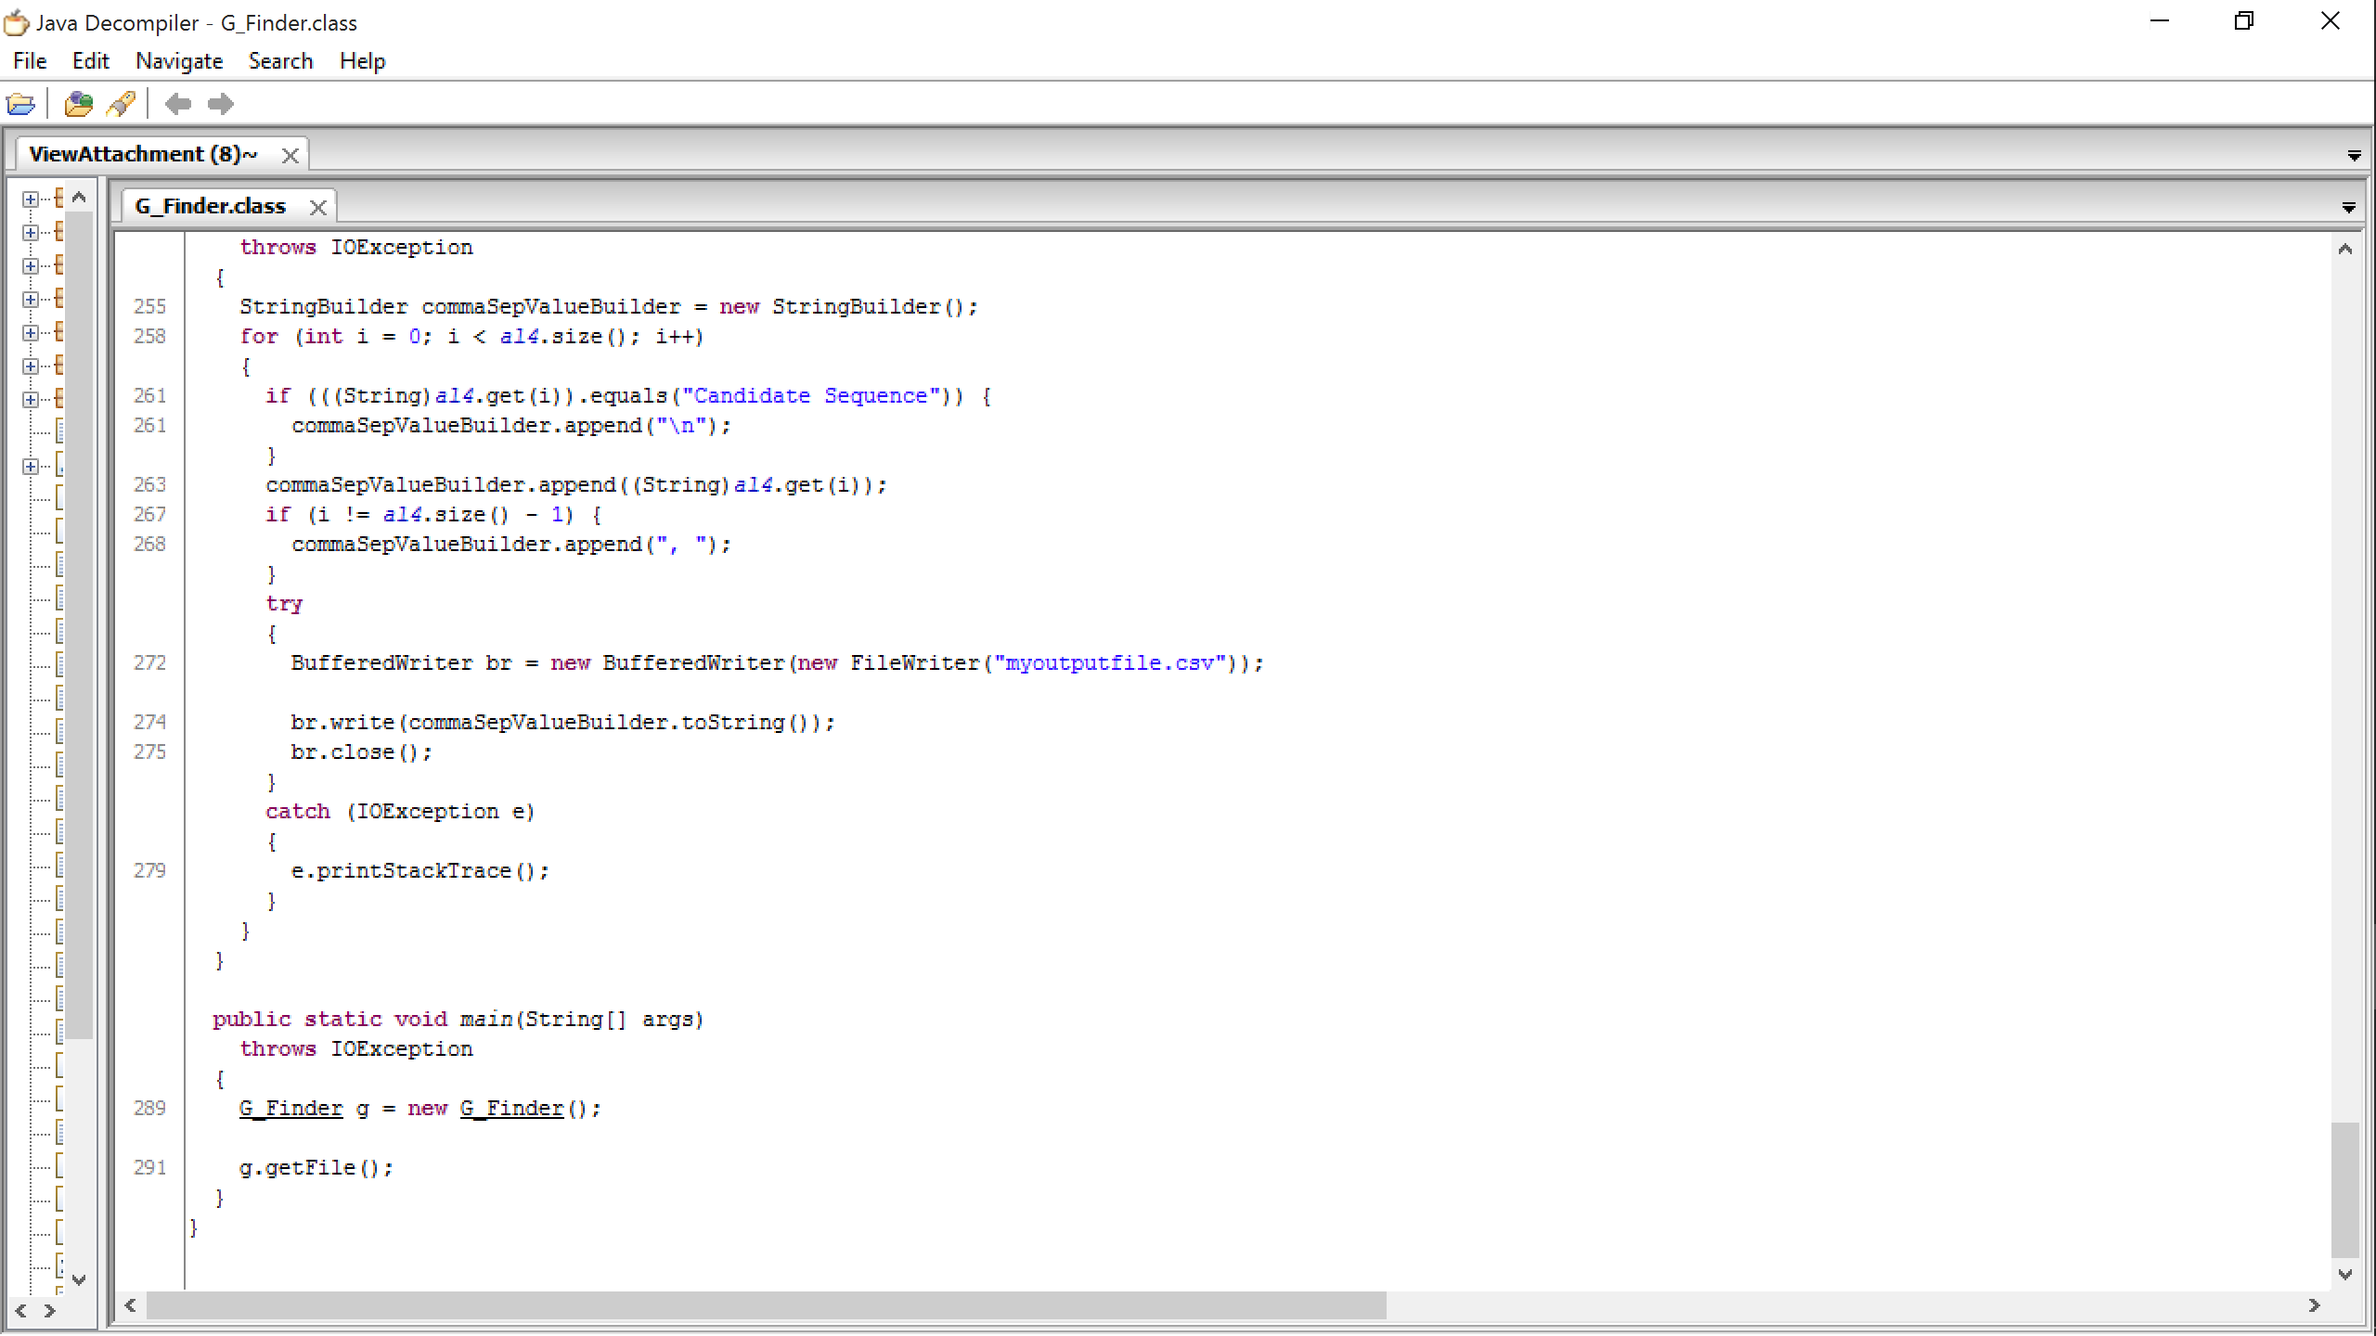
GFinder Code - generating output

Slide 17
GFinder Platform:
Local User Command-Line Interface

Slide 18
Pre-installation checklist and Installation
A recent Java SE Development Kit (ie. JDK 8) must be installed
Assign a folder for GFinder (for ie. GFinder_Folder)
Ensure that your high-speed internet connection has a consistent bandwidth
Have an accessible Command-line Terminal
GFinder Interface is packaged as an executable .jar file called “GFinder.jar”
Upon download, place the GFinder.jar file into the designated folder (ie. GFinder_Folder)
UMUC G-Quadraplex Identification Working Group
18

Slide 19
Deploying GFinder
Upon correct installation of GFinder, the user can operate the command-line interface by:
Setting the terminal environment to the directory containing the executable .jar, using the following command:
Windows → cd C:\Users\username\Documents\GFinder_Folder
UNIX → cd /Users/username/Documents/GFinder_Folder
** Note: the exact folder path can be found by right-clicking into the properties of the folder
UMUC G-Quadraplex Identification Working Group
19

Slide 20
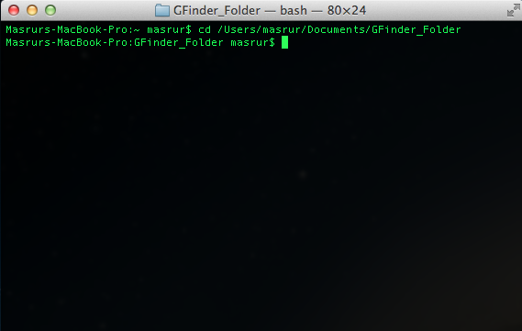
Deploying GFinder (cont.)
Changing directory for GFinder via Command-line Terminal
UMUC G-Quadraplex Identification Working Group
20

Slide 21
Deploying GFinder (cont.)
2. Executing the GFinder, using the following command :
Windows → java -jar GFinder.jar
UNIX → java -jar GFinder.jar
OR
Enable double-click execution (step-by-step instructions reviewed next)
UMUC G-Quadraplex Identification Working Group
21

Slide 22
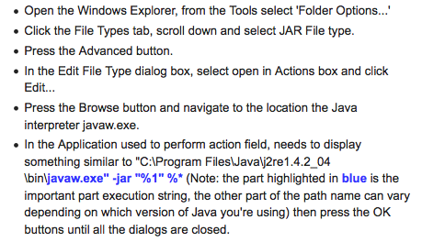
Deploying GFinder (continued)
UMUC G-Quadraplex Identification Working Group
22

Slide 23
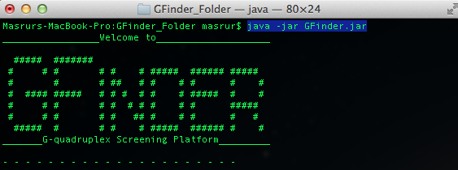
Deploying GFinder (continued)
Running the GFinder Interface
Welcome Screen to GFinder via Command-line Terminal
UMUC G-Quadraplex Identification Working Group
23

Slide 24
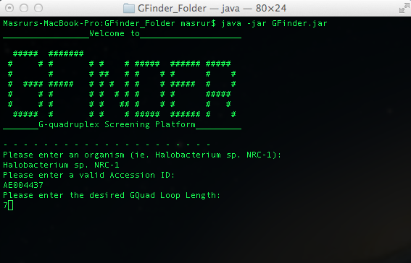
Deploying GFinder (continued)
Fig. 4 User-inputs for GFinder via Command-line Terminal
Specify Organism
Specify Accession ID
Specify Candidate Sequence Length (including lengths up to the specified request)
UMUC G-Quadraplex Identification Working Group
24

Slide 25
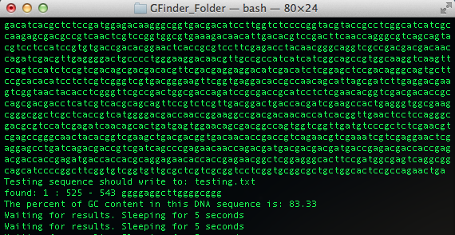
Deploying GFinder (continued)
Results in GFinder via Command-line Terminal then output to CSV file
respective genome found and recorded into a text file
Probe hit number and location of hit (bp #)
GC% of hit
Awaiting prospective hits
UMUC G-Quadraplex Identification Working Group
25

Slide 26
Review of GFinder Output

Slide 27
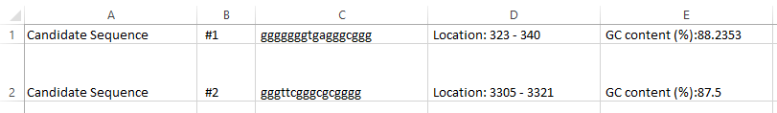
GFinder Output
Output produced as a structured CSV file
Columns A and B: enumeration of candidate G-quadruplex sequences found in genome as searched using by the regular expression in GFinder
Column C: contains sequence found by regular expression identified as the candidate G-quadruplex sequence
Column D: contains location by nucleotide number
Column E: contains calculated G-C content of candidate G-quadruplex sequence

Slide 28
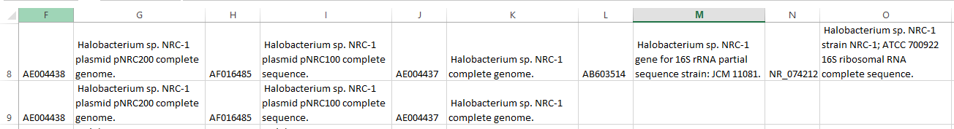
GFinder Output (cont.)
Column F (and potentially alternating columns following F): Column F contains accession ID of gene that the BLAST search first identified as being a hit.
additional hits found by BLAST searchthen appear in columns H, J, L, etc. (leaves columns available for description information on any hits)
Column G (and potentially alternating columns following G): Column G contains available description matching accession ID located in Column F and again corresponds to first hit found by the BLAST search.
additional hits found? descriptions appear in alternating columns such as I, K, M, etc. and correspond to the accession ID located in the prior column

Slide 29
Enhancing Bioinformatics Content in the APS Program

Slide 30
Enhancing Bioinformatics Content in the APS Program
SDSM&T’s applied biological science degree looking to expand extent of its bioinformatics content for its students
Role of the discipline in research is recognized as a priority
Already have one course as part of degree
In full production use since February 2000
G-Quadruplex Identification Working Group spent time discussing options
Structure of course also allowed opportunity to engage full class of students in project-specific discussion questions so this was posed to all to gather feedback

Slide 31
Enhancing Bioinformatics Content in the APS Program (cont.)
Robust internship and co-operative learning program already in place, but students may lack technical skills valued by companies.
Suggestion: In establishing opportunities, ask companies to name top two desired technical skills. Create a combined lists and allow students to incorporate an independent research project on one as part of a course taken in the semester or year prior to that working experience.
Expand use of analytical tools within existing laboratory courses to include an increased amount of applied work being done
Suggestion: Make working with NCBI tools a component of existing class or have students analyze image-based data produced by projects at SDSM&T. Exercises could be designed around masked yet published data so comparisons could be made at end of assignment/exercise.

Slide 32
Enhancing Bioinformatics Content in the APS Program (cont.)
Bioinformaticians often prioritize Linux, but the ability to use it is often picked up independently or on the job rather than in school.
Suggestion: Collaborate with CS department to have professor or teaching assistant oversee execution of existing project requirement to be done in Linux specifically.
Is any current faculty member working in the applied biological science degree already familiar enough with Linux ?
Increase working familiarity with at least some of the multiple programming platforms used in bioinformatics as many are open source or are freely available
Suggestion: For any type of data analysis or calculating, incorporate use of R, Perl, SAS or other applicable software/language. Might start as an extra credit offering while faculty also gains familiarity. Possibly utilize a CS TA to support current faculty?

Slide 33
Enhancing Bioinformatics Content in the APS Program (cont.)
Collaborate with other universities to provide access to wider array of course offerings, potentially as upper level electives, without having to do course development in-house.
Suggestion: Strong offerings at South Dakota State University. Other schools including UNC-CH, NYU, BU, GWU (even UMD!) would provide good options if a cross-collaborative arrangement could be made.
Partnering school likely to be interested in applied content of current program.

Slide 34
THANK YOU
from the G-Quadruplex
Identification Working Group!
Please feel free to be in touch with questions about GFinder

